Slide 1





mobile dev ops
at a web cadence
@ryanjsalva

Slide 2

Cowboy Coders

Slide 3
But why?
Streamline the development
of your mobile app(s)
Automate the process to be
repeatable and sustainable
Release frequently
Maintain quality
Monitor app health and engagement
Continuous Integration (CI)
Continuous Delivery (CD)
Continuous Monitoring (CM)

Slide 4

Automation means
more naps
Phil Wood Photo

Slide 5
Five technologies
Apache Cordova for mobile app development

Slide 6
Five technologies
Apache Cordova for mobile app development
Visual Studio Team Services for CI / CD

Slide 7
Five technologies
Apache Cordova for mobile app development
Visual Studio Team Services for CI / CD
Gulp for build task management

Slide 8
Five technologies
Apache Cordova for mobile app development
Visual Studio Team Services for CI / CD
Gulp for build task management
Hockey App for beta testing

Slide 9
Five technologies
Apache Cordova for mobile app development
Visual Studio Team Services for CI / CD
Gulp for build task management
Hockey App for beta testing
Code Push to update our app in production

Slide 10
Five technologies
Apache Cordova for mobile app development
Visual Studio Team Services for CI / CD
Gulp for build task management
Hockey App for beta testing
Code Push to update our app in production
And, of course, git for source control

Slide 11
Chapter I
The best test is the one you don’t have to run

Slide 12
Chapter II
Can’t someone else test it?

Slide 13
How can you get early feedback from your testers on every build?

Slide 14



Collect user feedback through a continuous beta program
Automatically deploy new builds from your CI server
Monitor crash reports to catch issues early

Slide 15
Hockey App
Distribution
In-house app store
Notify testers of updates
Crash Reporting
Real-time collection
“Symbolicated” stacks
Feedback
Gather in-app feedback
Respond directly to testers

Slide 16




dev
merge
merge
merge
beta
merge
merge
release

Slide 17
Chapter III
… in which we deploy when we please.

Slide 18
How can you release app updates even quicker, by skipping the app store submission entirely?

Slide 19
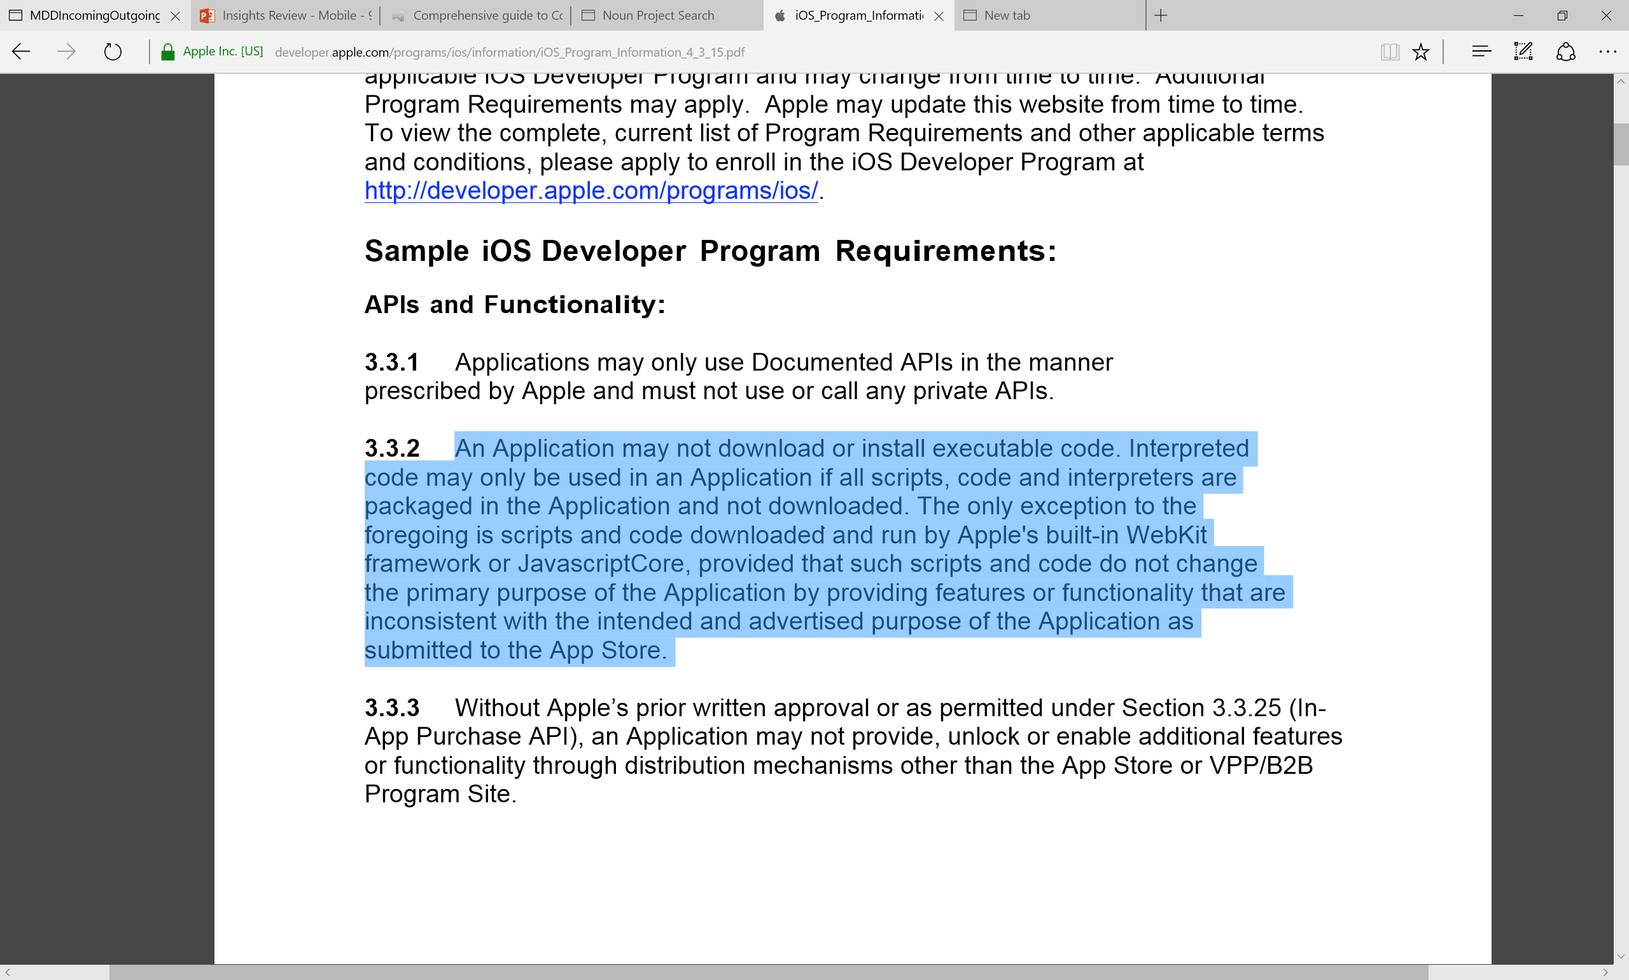

Slide 20
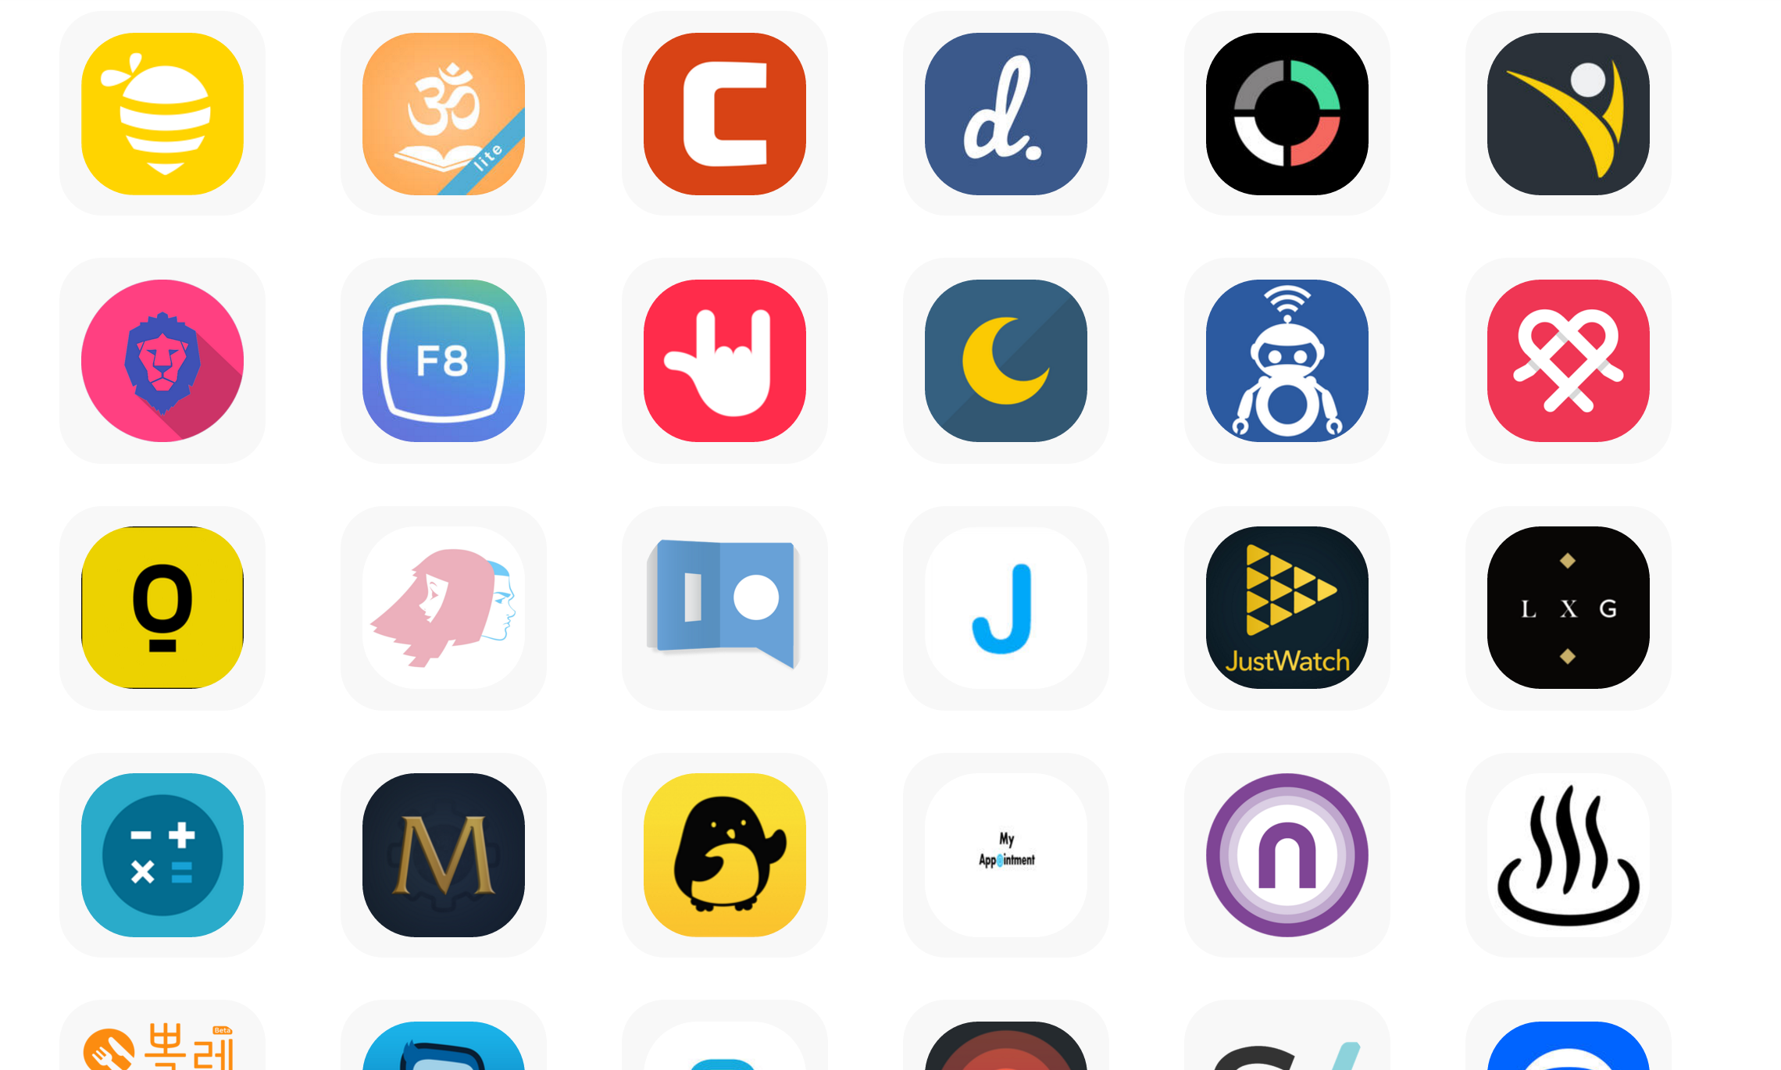

Slide 21
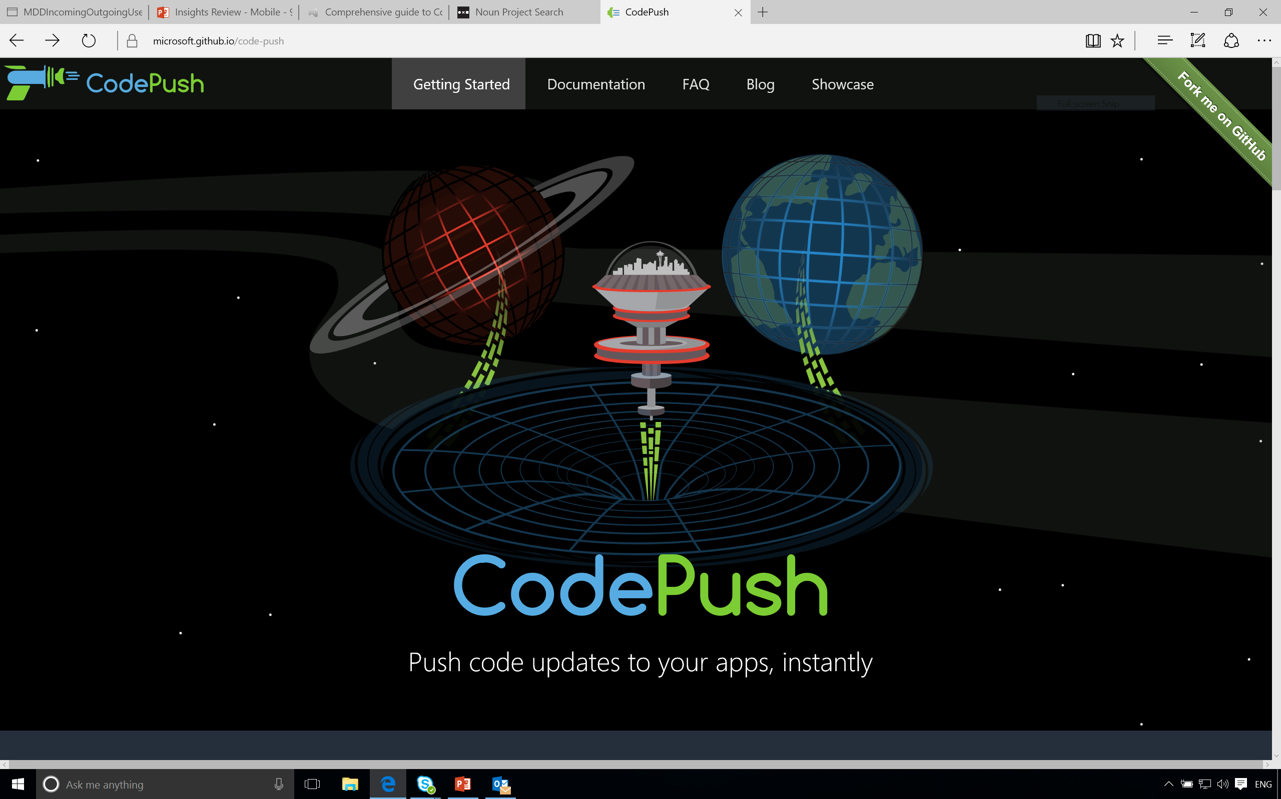

Slide 22

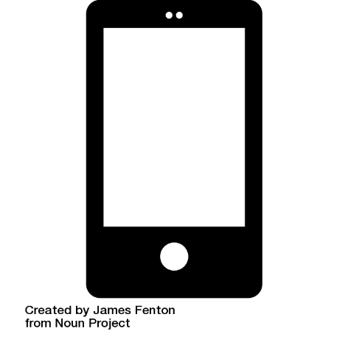

Azure says, “Yup! Here’s a ZIP with all the web assets.”
After a successful build, VSTS sends a package to Azure with the web assets
Phone asks, “Hey, Azure! Do you have an update for me?”
TA-DA!
Code-Push extracts ZIP and replaces the contents of /www
After receiving a new commit, Visual Studio Team Services builds the app

Slide 23
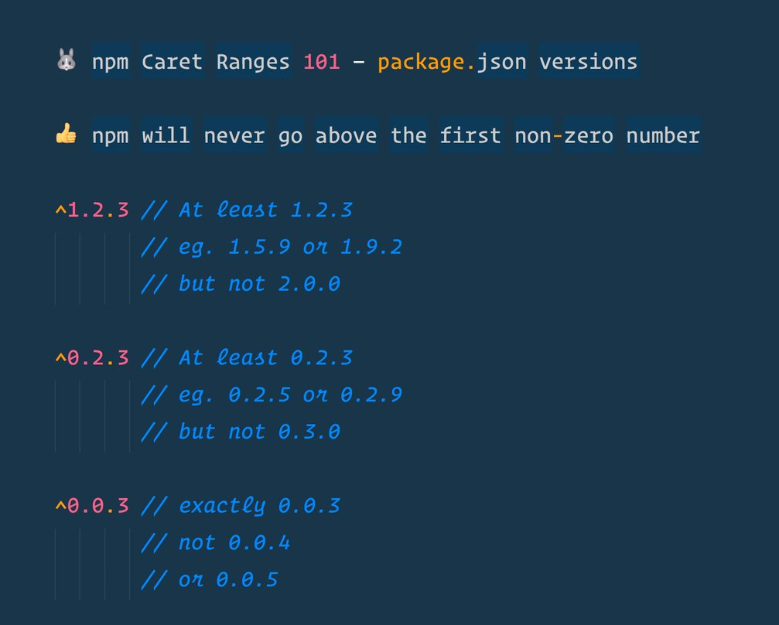

Slide 24
We’re just scratching the surface
Full support for both Android and iOS
Team collaboration
Staged and mandatory rollouts
Retract updates with “rollback”
HockeyApp integration
VSTS extensions to release directly to the stores
Cloud build for iOS using MacInCloud

Slide 25
If you want to learn more…
Visual Studio Team Services http://visualstudio.com
Hockey App http://hockeyapp.net
CodePush http://codepush.tools
Visual Studio Code http://code.visualstudio.com
This sample project http://aka.ms/mdo-rjs
Follow me on Twitter @ryanjsalva

Slide 26
Instantly Releasing Mobile Updates What is currently inhibiting it?
Cordova and React Native apps are offline by design
Store distribution introduces release latency
End user update adoption is unpredictable

Slide 27
Microsoft Code-Push
Getting started in six easy steps
1. Install the CLI
4. Install the SDK
npm install –g code-push-cli
cordova plugin add cordova-plugin-code-push
2. Create an account
5. Consume the API
code-push register
codePush.sync();
3. Create a CodePush app
6. Release an update
code-push app add MyApp
code-push release-cordova MyApp ios

